Slide 1
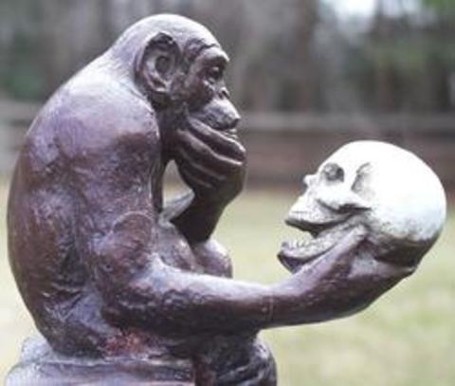
Comparing Humans & Apes

Slide 2
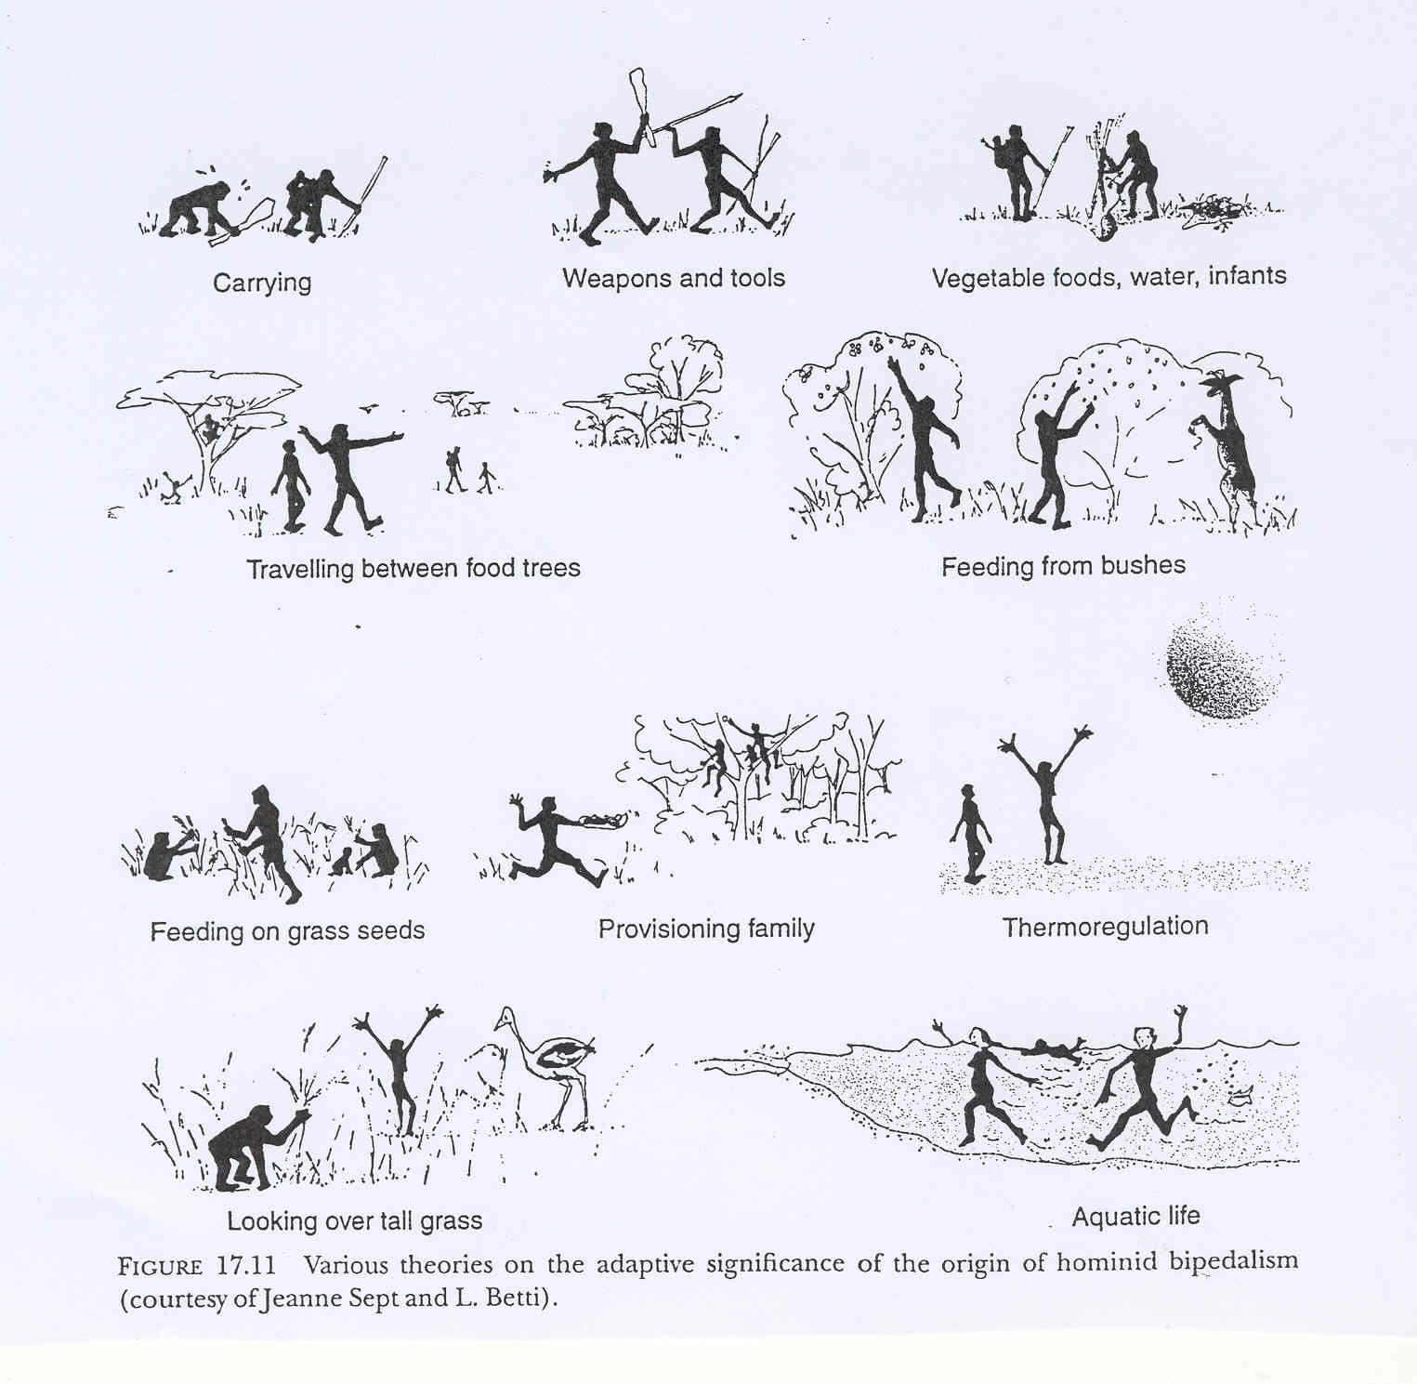
Why Bipedalism?

Slide 3
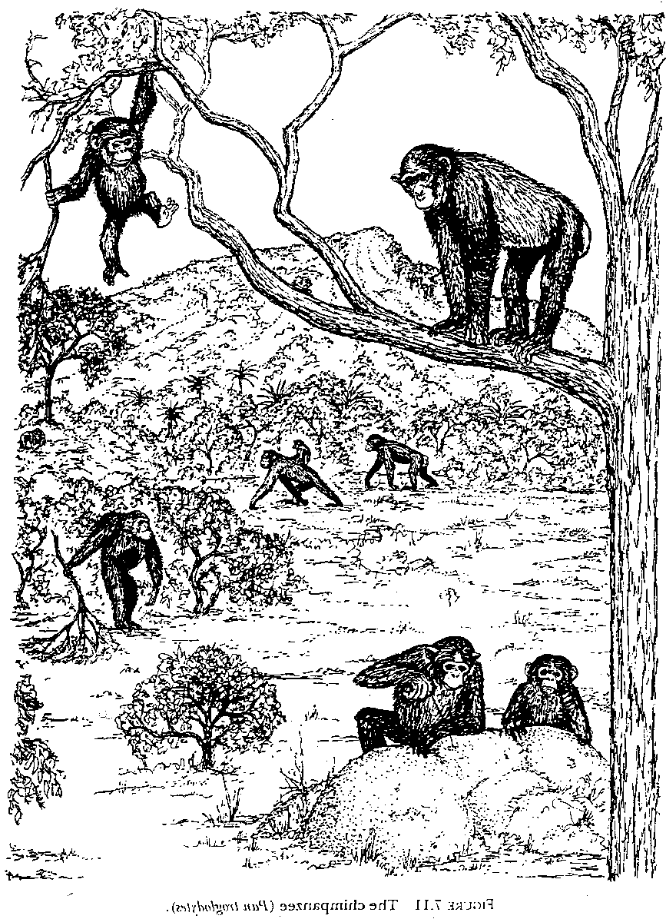
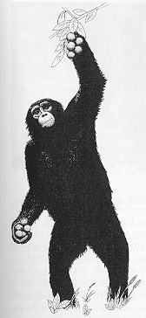
Chimpanzees & bipedalism
Chimpanzees use a variety of postures.
Their main mode of slow locomotion on the ground is knuckle-walking, as shown by the pair in the distance in the illustration on the left.
Bipedal postures and, occasionally, brief periods of locomotion are seen most frequently during threat displays (left) or when feeding (right).

Slide 4
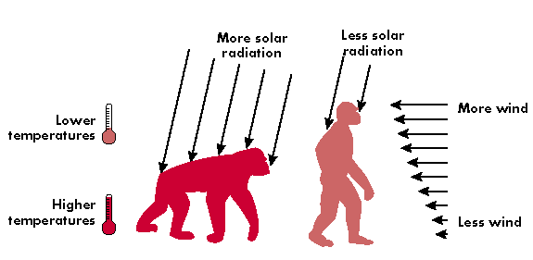
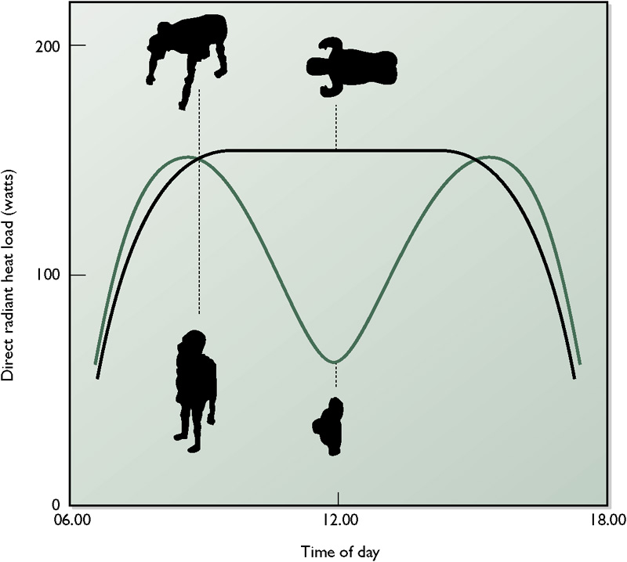
Thermoregulatory model of bipedalism
The figure below shows that an upright stance means that a bipedal hominoid would absorb 60% less heat at midday than a quadrupedal hominoid.
Lewin & Foley (2003) Figure 9.17
The diagram above illustrates how bipedal locomotion helps an animal living in warm climates to keep cool –
by reducing the amount of sunlight that falls on the body,
by increasing the animal’s exposure to air movements
and by immersing it in lower temperature air.
Boyd & Silk (2003)

Slide 5
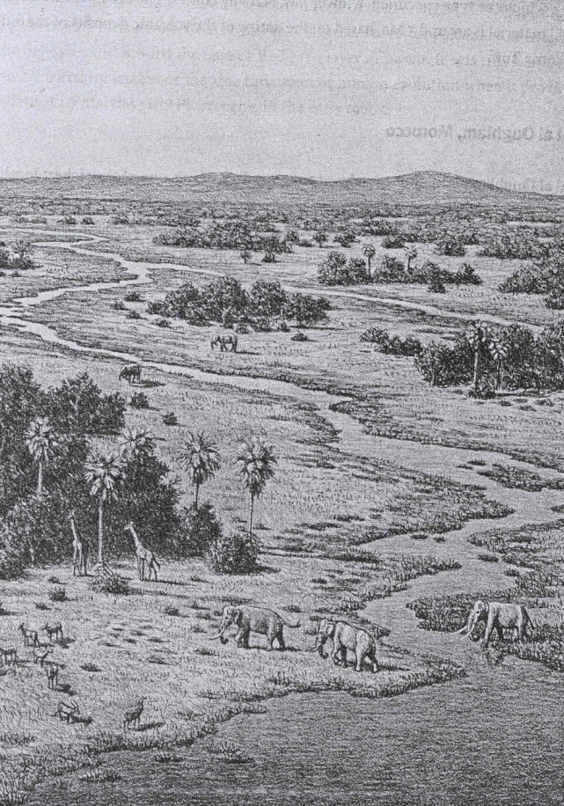
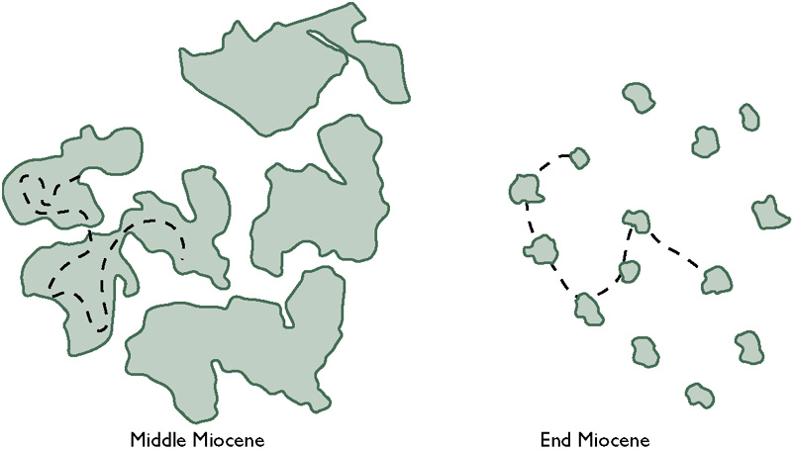
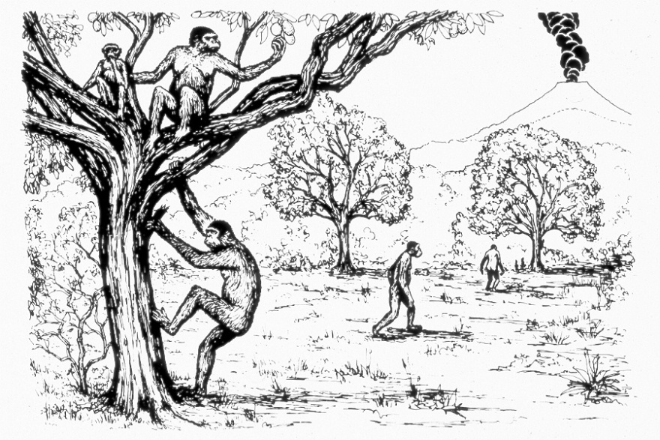
Habitat change
In the latter part of the Miocene the forests start to break up because of climatic drying. As shown above, this means that the daily range of an ancestral hominin would no longer be encompassed by continuous forest. The two pictures on the right give impressions of the Afar region of Ethiopia at the beginning of the Pliocene, showing the clumps of woodland interspersed in more open habitat.
Figures (clockwise from top) from Lewin & Foley (2003); Turner & Anton (2004); Fleagle (1999).

Slide 6
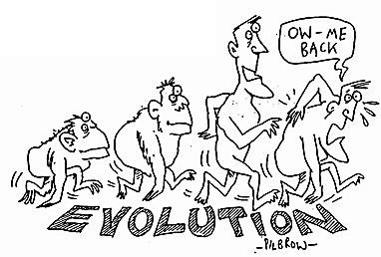
Advantages & disadvantages of bipedalism (page 204)
Advantages
See further
Hands free
Carry baby, food
Throw stones
Keep cool (less sun, more wind)
Look bigger
Display sex organs
Disadvantages
Back ache
Birth problems
Takes time to learn
Varicose veins

Slide 7
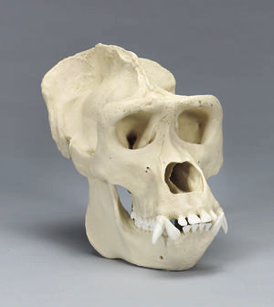
Gorilla skull
Nuchal crest
Sagittal crest
Brow ridge
Zygomatic arch (cheek bone)
Canine teeth
Diastema (gap)

Slide 8
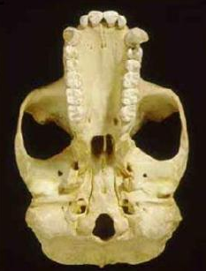
Another Gorilla
U-shaped dental arcade
Zygomatic arch
Occipital condyle
Foramen magnum

Slide 9
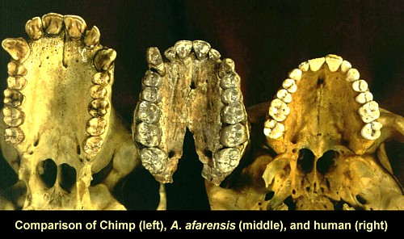

Slide 10
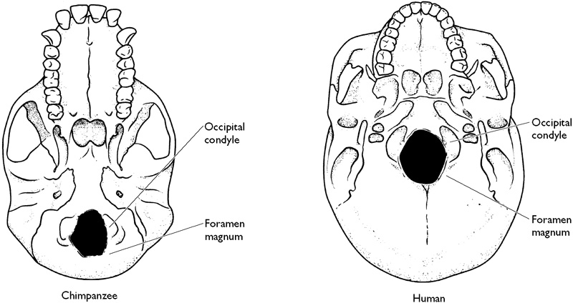
The position of the foramen magnum
Because the skull is perched on top of a vertical spine in a biped, the foramen magnum - the “large hole” through which the spinal cord enters the cranium – is located towards the centre of the skull. In apes it is further back.

Slide 11
Postcranial = the rest of the skeleton not including the skull

Slide 12
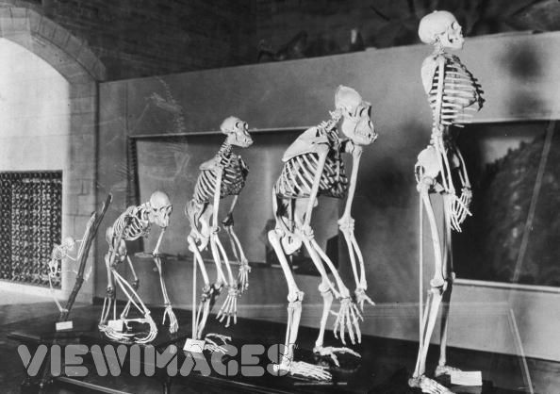

Slide 13
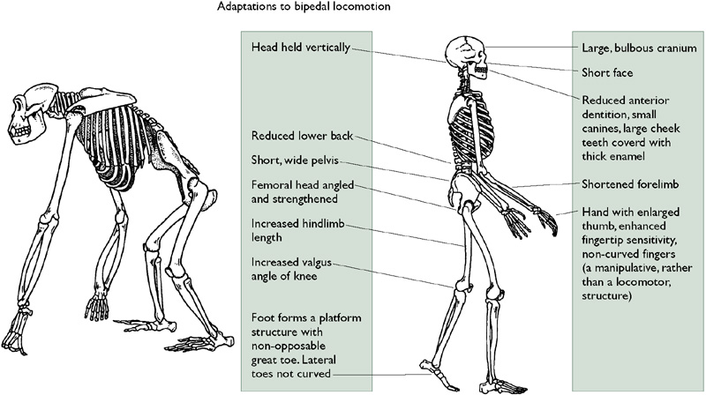
Comparison
Modern human
Modern African ape

Slide 14
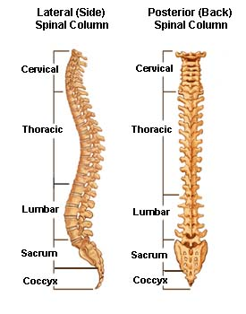
The Spine

Slide 15
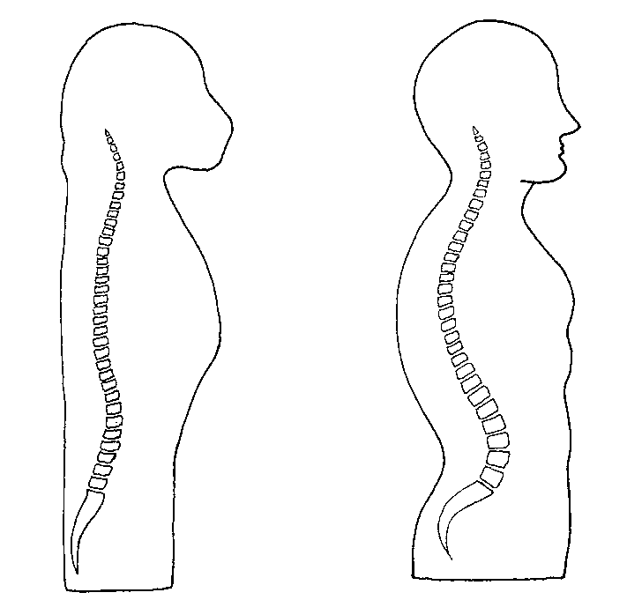
Ape/human Comparison
The human spine is said to be ‘S-shaped, but has 4 curves that bring the centre of gravity above the pelvis.

Slide 16
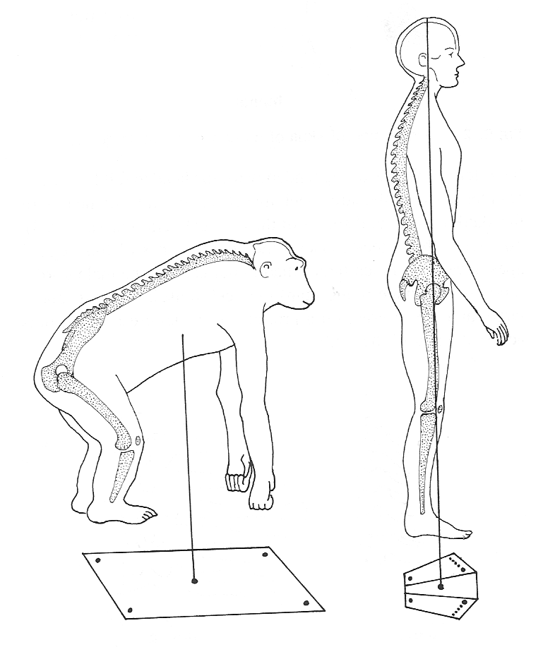
Centre of gravity

Slide 17
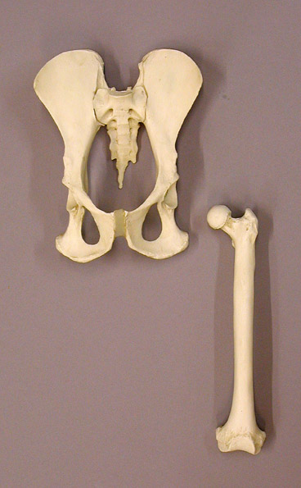
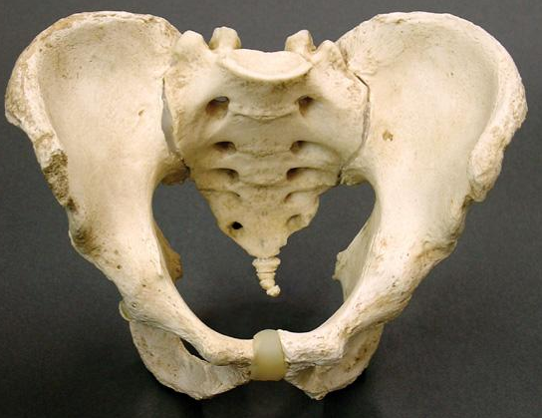
Bonobo and human pelvis

Slide 18
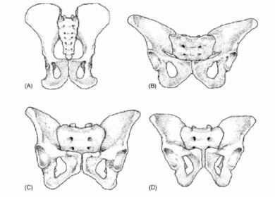
The Pelvis
Australopithecus
Chimp
Human female
Human male
In apes the pelvis is long and narrow, and has a box-like shape. In humans it is short and broad and is bowl shaped. This allows it to transmit all the body weight to the legs through the hips.

Slide 19
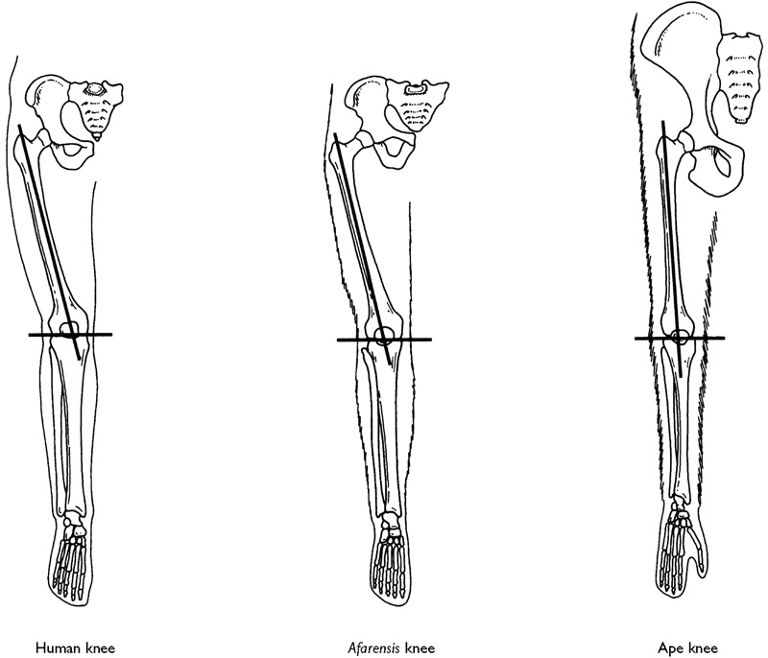
Valgus Angle
Valgus angle
In humans and other bipedal hominins the knee is angled in towards the midline of the body, bringing it under the centre of gravity.
In apes it is not.

Slide 20
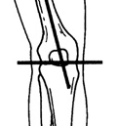
The knee
The outer condyle of the human knee is larger than the inner one as it takes the weight.
In apes the reverse is true.
The knee can lock and keep the legs straight so our weight is supported by the bones.
We can stride with less energy use than an ape whose legs are bent and muscles must be used to support their weight. They must also waddle.

Slide 21
Feet
We have shorter toes.
The big toe is larger and directed forward. It provides the final thrust in walking while the others help with balance.
Our foot is arched, helped by ligaments. This conserves energy.

Slide 22
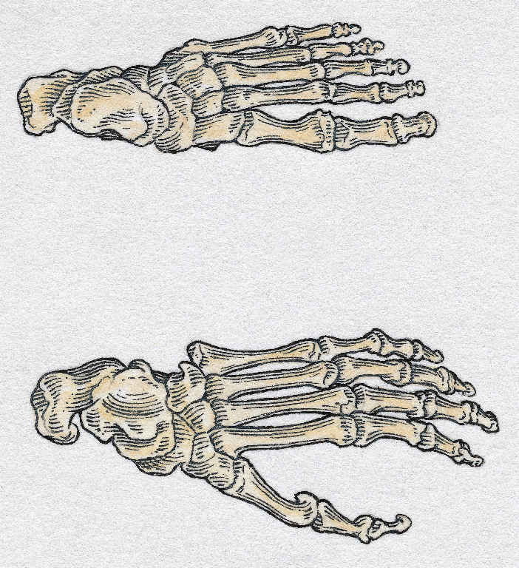
Human and gorilla feet

Slide 23
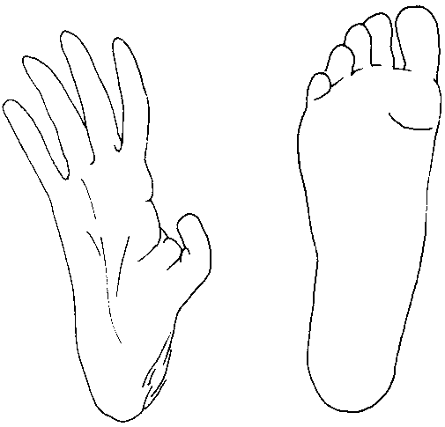
Orangutan and Human

Slide 24
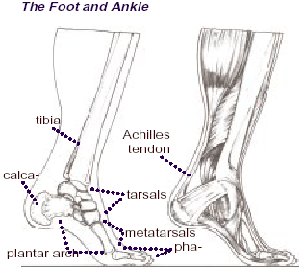

Slide 25
Hands
Hand bones of juvenile gorilla,
Homo habilis, and modern
human are compared.
Top row: Phalanges shown in
lateral view. Curvature in
extended position decreases
toward the human.
Middle row: Terminal phalanx
increases in breadth.
Bottom row: Relative length of
thumb, and angle between
thumb and index finger,
increase toward human.

Slide 26
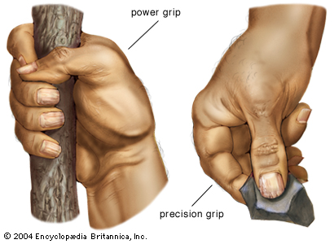
Get a grip
The longer, more mobile human thumb can be opposed to all of our fingers to give us the precision grip. This, along with our more sensitive finger pads enables us to manipulate objects better than apes.

